Slide 1
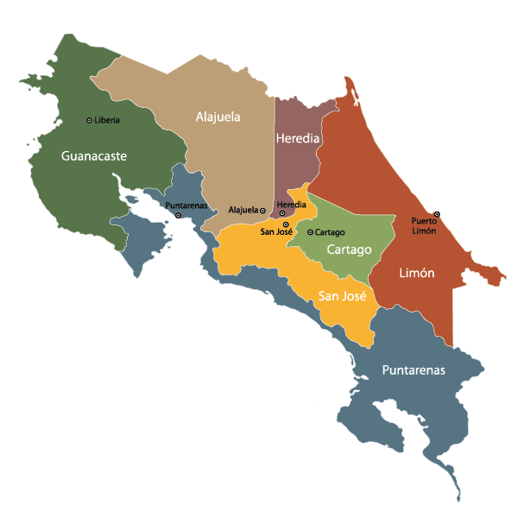
Costa Rican Household Poverty Level Prediction
Instructor:
Dr. José Unpingco
Date: 12/7/2018
Group 7:
Scott Zhao
Yuchun Hsieh
Qihan Zhang
Gantum Nain

Slide 2
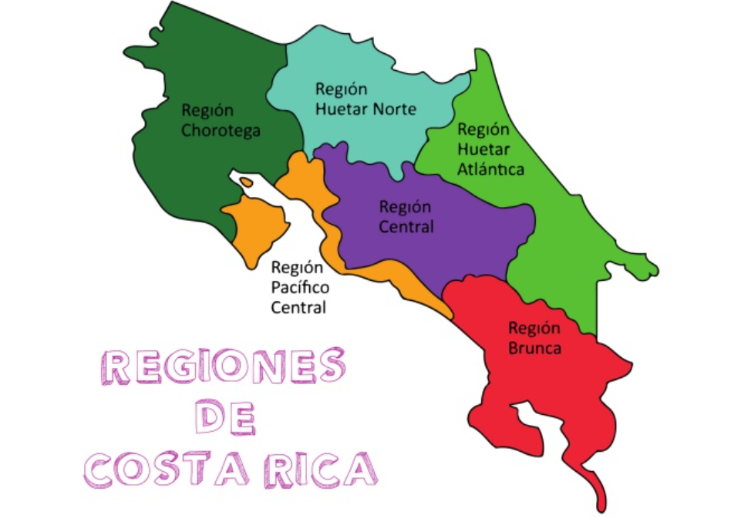
Introduction for Costa Rica
Population: 4,857,274 people
Density: 84/km²
Poverty index: 21.1% in 2018 (1,142,069 people in poverty, while 360,783 people live in extreme poverty.)

Slide 3
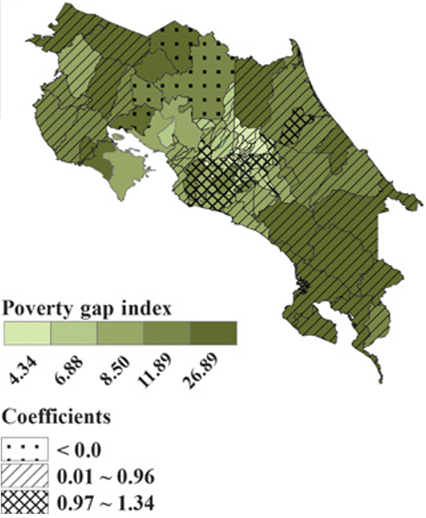
Motivation
The big poverty gap in Costa Rica is always a serious problem.
Investigating different relations between socio-economic parameters is worthy.
Visualizing the dataset make us more understand the society in Costa Rica.

Slide 4
Datasets
IDB Costa Rican Household Dataset: Contain different socio-economic indicators of 9558 Households to train the model to classify their Poverty level. In the test dataset it contains socio-economic data for 23K Households.
INEC Costa Rica Dataset: Provide information about education in different regions in years.
Google and twitter

Slide 5
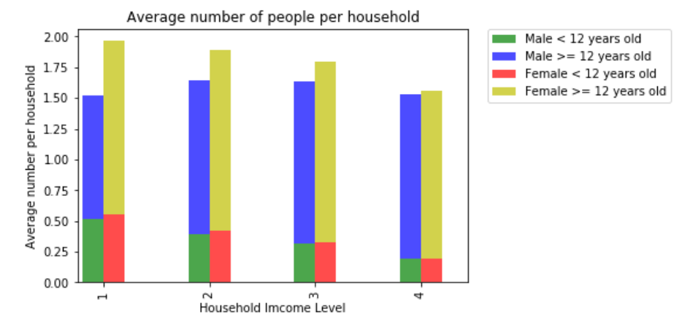
Household
The household with higher income level tends to have less children
1 = extreme poverty
2 = moderate poverty
3 = vulnerable households
4 = non vulnerable households

Slide 6
Economy

Slide 7
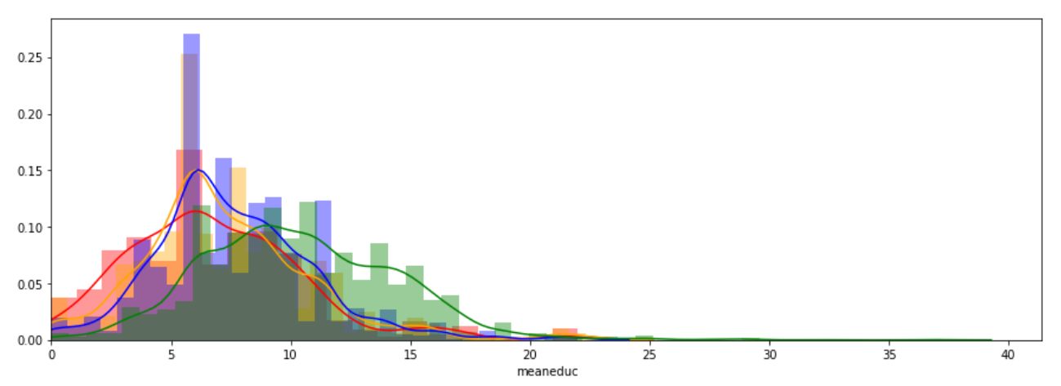
Education

Slide 8
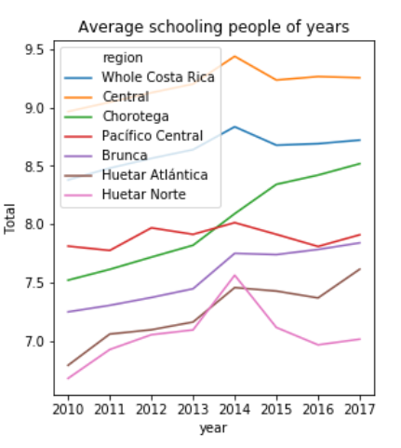
Education

Slide 9
Conclusion

